Slide 1
Pub/Sub Middleware for WSN
Steven Lai

Slide 2
System Model
A group of sensor nodes are deployed in certain area and they can connect with each other (through one-hop or multihop).
Users can subscribe to the WSN with the language provided by the system.
In order to do so, each user should have a sensor node attached to a terminal (PC).
Such node can either be one of the node in the network or the user may bring a new node.

Slide 3
System Overview
After the user finish writing the program, the program will be compiled on the terminal.
The compiled program will be smaller and understandable by the sensor nodes.
The system will then work in a similar manner to other middleware approaches such as ‘Deluge’ and ‘Agilla’ in the sense that users may ‘reprogramming’ the network so as the system can perform specific tasks for the users.

Slide 4
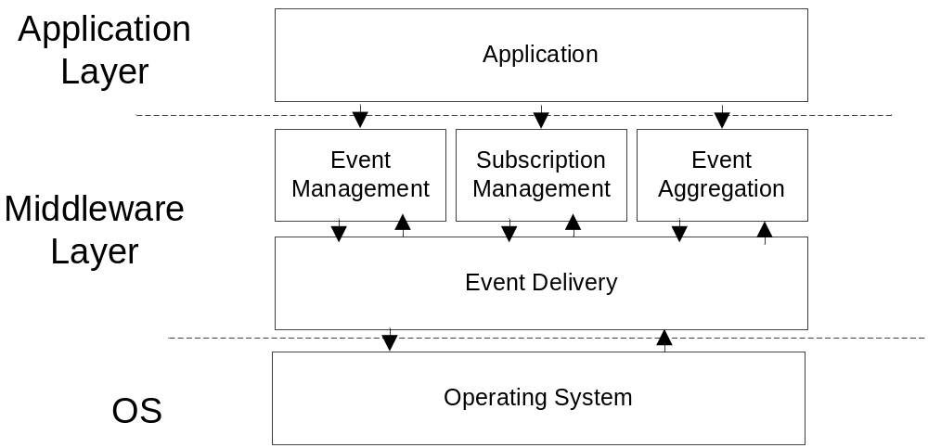
Software Architecture

Slide 5
Architecture
The middleware layer has 2 parts: Event Delivery is the Directed Diffusion module that I have just implemented.
The Management layer above event delivery layer is responsible for storing and maintaining the subscriptions.
The application layer is mainly an interpreter for the ‘compiled’ programs and it can have different behaviors depending on the programs.

Slide 6
API Provided by Directed Diffusion
API used by Subscriber:
  interface SendSub;
  interface ReceiveEvent (source id);
API used by Publisher
  interface ReceiveSub;
  interface SendEvent (dest id);

Slide 7
Implementation Details of Directed Diffusion
Each node will maintain a neighbor list.
When receiving a subscription, the node will update its neighbor list.
Each list entry has the following fields:
  originaddr (original address of the subscriber)
  nexthop [MAX] (list of available next hops to reach the originaddr)
For each of the nexthop, the corresponding cost and status (active/inactive) will be recorded.

Slide 8
Implementation Details of Directed Diffusion
Publisher will publish events along the paths created during subscription propagation.
Negative propagation will be sent if multiple events are received. The paths with higher cost will be deactivated.

Slide 9
Works for the Incoming Week
Subscriptions Maintenance
  How to distribute events evenly in the network.
Extensions to Directed Diffusion
  Error recovery: caused by node failure or some ‘hot spot’ in the network.
  Efficient multicast: when multiple subscribers share the same path, events may be sent by only once.

